Slide 1
Understanding Decision Trees
Notes:
binary classification: http://mfviz.com/binary-predictions/
This lecture is mostly to give you a basic understanding of the vocabulary of machine learning.
ogistic regression: https://towardsdatascience.com/logistic-regression-using-python-sklearn-numpy-mnist-handwriting-recognition-matplotlib-a6b31e2b166a
PCA (dimensionality reduction using Python): https://towardsdatascience.com/pca-using-python-scikit-learn-e653f8989e60
Regression Trees: https://github.com/jakevdp/sklearn_tutorial/blob/master/notebooks/03.2-Regression-Forests.ipynb
This lecture is going to take forever to go over. More than a couple classes. There is no possible way I could cover this in one, two, or even three lectures.
Check Kaggle Tutorial: https://www.kaggle.com/crawford/python-groupby-tutorial/data
Check Cancer Dataset (groupby boxplot thing):
https://github.com/mGalarnyk/Python_Tutorials/blob/master/Statistics/confidence_interval/confidence_interval_good.ipynb
Finish Jake Vanderplas thing: https://jakevdp.github.io/PythonDataScienceHandbook/03.08-aggregation-and-grouping.html

Slide 2
Outline
What is a Decision Tree
Understand how decision trees work in order to understand its strengths and weaknesses.
Build a Decision Tree for Regression versus Classification
Importance of Trying to Visualize your Model
Visualizing Decision Trees
Exercises
Notes:
Prework Review:
Implement a linear model with the sklearn and statsmodels libraries
Understand what a regression coefficient is
Recall metrics such as accuracy and misclassification
Recall the differences between lasso/L1 and ridge/L2 regularization

Slide 3

Where are we in the machine learning universe?
Notes:
Important to point out that you really do need more than 50 samples.
Check Jake Vanderplas

Slide 4
Where are we in the machine learning universe?
Notes:
Important to point out that you really do need more than 50 samples.
Check Jake Vanderplas

Slide 5
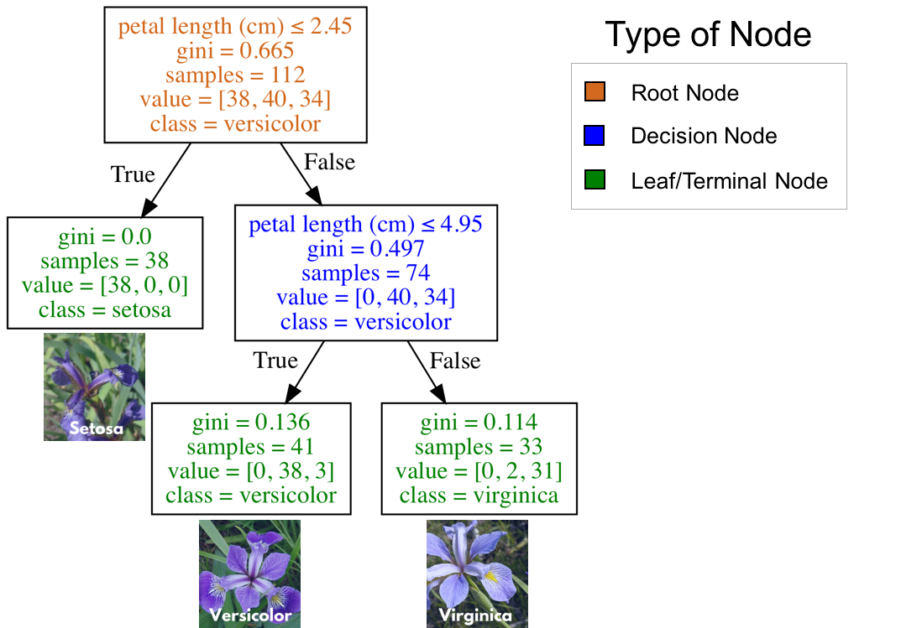
What are Decision Trees?
A supervised learning algorithm which is essentially a series of questions designed to assign a class or value
Decision trees used for classification are called classification trees
Decision trees used for regression are called regression trees.
Benefits include:
Highly interpretable
Prediction is fast
Can be used for classification or regression
Better performance in nonlinear settings (they use interactions between variables)
don’t require feature scaling
Flaws
Without pruning/cross-validation, they are prone to overfitting
Small variations in the data can result in a completely different tree
They don’t work well with highly unbalanced classes
Classification tree (decision tree) to classify one of three flower species (IRIS Dataset)
Notes:
They are non-parametric (i.e. will outperform linear models if the relationship between features and response is highly non-linear).
Common practice is to assign the negative class as the absence of something (ie absence of a tumor), but it doesn’t really matter what you assign what.
positive class typically is the presence of something we are looking for.
This example is just with two classes. Later on, with our digits example, we will talk about multiclass classification problems as well. in that case our variable y can take on multiple values {0, 1, 2, 3, 4, 5, 6, 7, 8, 9}

Slide 6
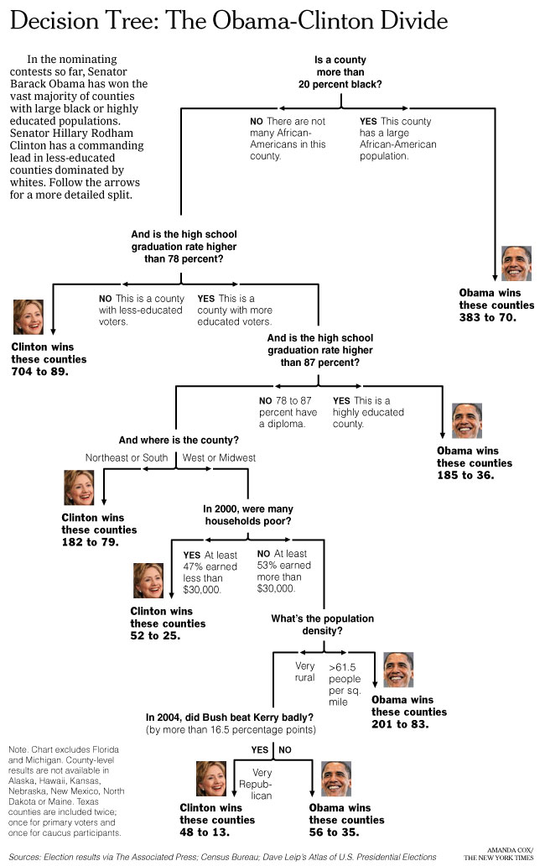
What are Decision Trees?
An algorithm used to solve supervised learning (classification/regression) problems.
Decision trees used for classification are called classification trees
Decision trees used for regression are called regression trees.
Benefits include:
Highly interpretable
Prediction is fast
Can be used for classification or regression
Better performance in nonlinear settings (they use interactions between variables)
don’t require feature scaling
Flaws
Without pruning/cross-validation, they are prone to overfitting
Small variations in the data can result in a completely different tree
They don’t work well with highly unbalanced classes
Source: http://graphics8.nytimes.com/images/2008/04/16/us/0416-nat-subOBAMA.jpg
Notes:
Predict whether Obama or Clinton would win the Democratic primary in a county in 2008.
I like this lecture a little: https://www.coursera.org/learn/practical-machine-learning/lecture/EALzX/predicting-with-trees
Common practice is to assign the negative class as the absence of something (ie absence of a tumor), but it doesn’t really matter what you assign what.
positive class typically is the presence of something we are looking for.
This example is just with two classes. Later on, with our digits example, we will talk about multiclass classification problems as well. in that case our variable y can take on multiple values {0, 1, 2, 3, 4, 5, 6, 7, 8, 9}

Slide 7
What are Classification Trees?
Classification trees are essentially a series of questions designed to assign a classification.
Root (brown) and decision (blue) nodes contain question which split into subnodes.
The root node is just the topmost decision node (it is where you start traversing the classification tree).
The leaf nodes (green) also called terminal nodes, are nodes that don’t split into more nodes.
Leaf nodes are where classes are assigned.
Classification tree (decision tree) to classify one of three flower species (IRIS Dataset)
Notes:
Common practice is to assign the negative class as the absence of something (ie absence of a tumor), but it doesn’t really matter what you assign what.
positive class typically is the presence of something we are looking for.
This example is just with two classes. Later on, with our digits example, we will talk about multiclass classification problems as well. in that case our variable y can take on multiple values {0, 1, 2, 3, 4, 5, 6, 7, 8, 9}

Slide 8
Basic Algorithm
Start with all variables in one group
Find the variable/split that best separates the oucomes
Divide the data into two groups (“leafs”) on that split (“node”)
Within each split, find the best variable that separates the outcomes.
Continue until the groups are too small or sufficiently ”pure”
Classification tree (decision tree) to classify one of three flower species (IRIS Dataset)
Notes:
Common practice is to assign the negative class as the absence of something (ie absence of a tumor), but it doesn’t really matter what you assign what.
positive class typically is the presence of something we are looking for.
This example is just with two classes. Later on, with our digits example, we will talk about multiclass classification problems as well. in that case our variable y can take on multiple values {0, 1, 2, 3, 4, 5, 6, 7, 8, 9}

Slide 9
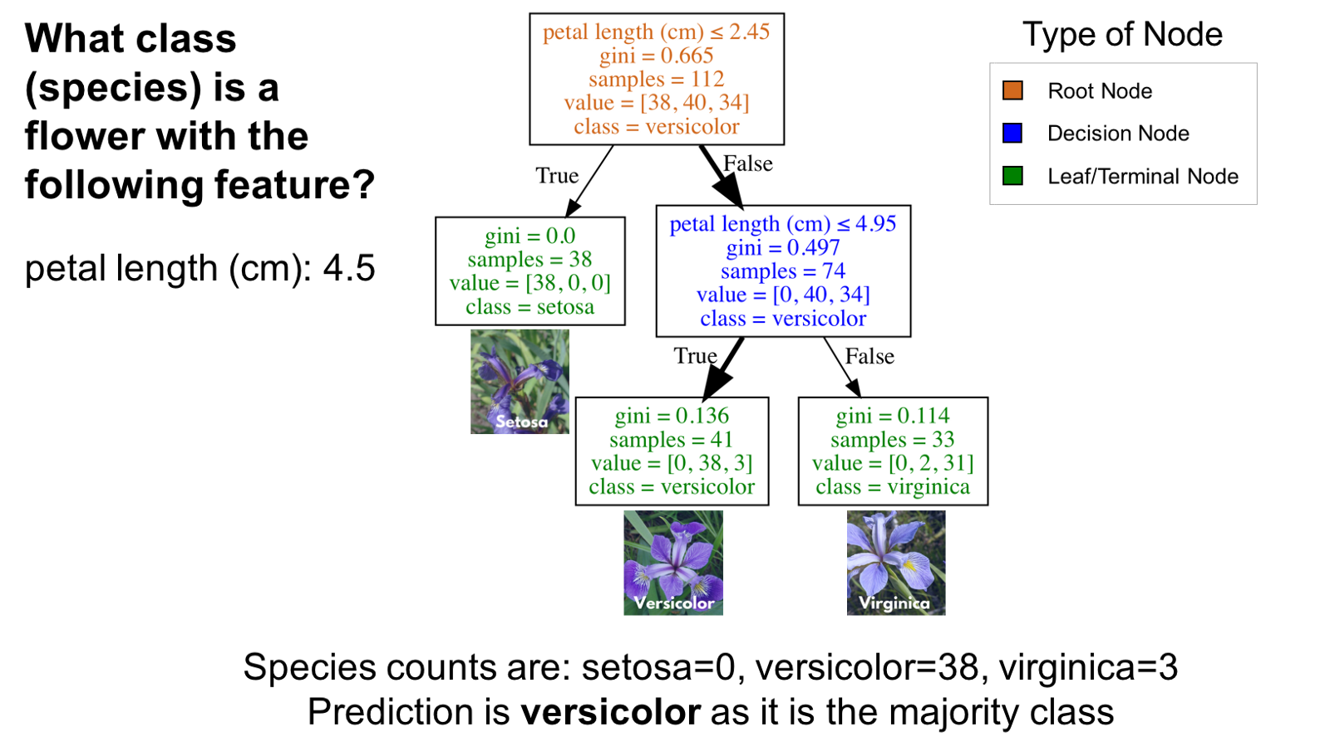
How to use a classification tree
Start at the top of the classification tree (root node) and traverse the tree until you reach a leaf (terminal) node.
In the image to the right, imagine you had a flower with a petal length of 4.5cm and you wanted to classify It.
Notes:
Common practice is to assign the negative class as the absence of something (ie absence of a tumor), but it doesn’t really matter what you assign what.
positive class typically is the presence of something we are looking for.
This example is just with two classes. Later on, with our digits example, we will talk about multiclass classification problems as well. in that case our variable y can take on multiple values {0, 1, 2, 3, 4, 5, 6, 7, 8, 9}

Slide 10
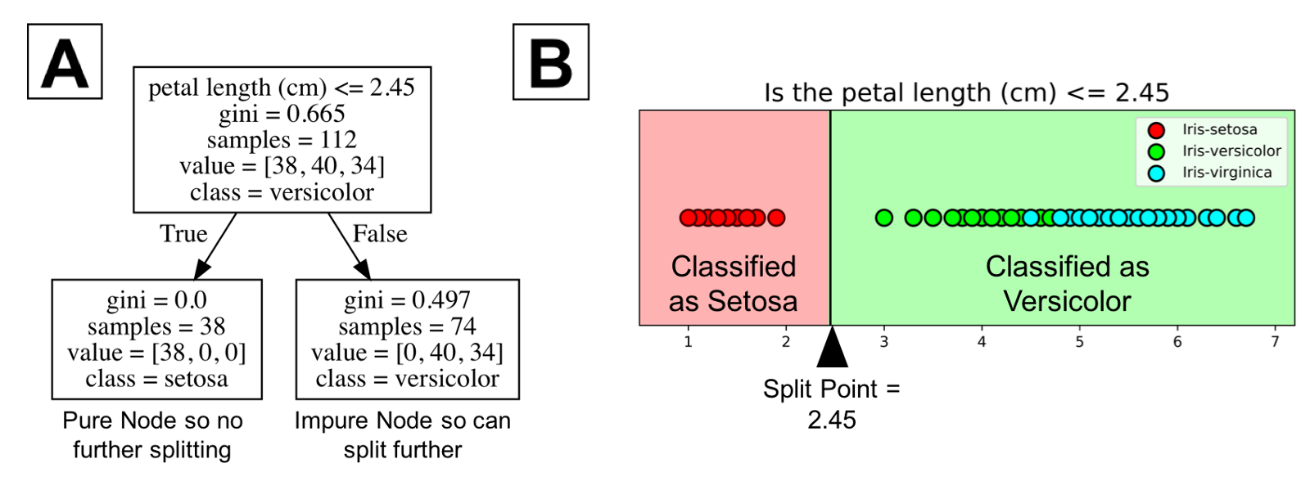
How to use a classification tree
A tree learns a sequence of if then questions with each question involving one feature and one split point.
Look at the partial tree to the right
the question, “petal length (cm) <= 2.45” splits the data into two branches based on some value. The value between the nodes is called the split point.
The split point the root node is 2.45.
In part B of the figure, all the points to the left of the split point are classified as setosa while all the points to the right of the split point are classified as versicolor.
The setosa was correctly classified for all 38 points. It is a pure node. Classification trees don’t split on pure nodes (it would result in no further information gain).
Impure Nodes can split further. Classification trees are a greedy algorithm which means it will continue to split until it has a pure node (unless you stop it).
Notes:
Common practice is to assign the negative class as the absence of something (ie absence of a tumor), but it doesn’t really matter what you assign what.
positive class typically is the presence of something we are looking for.
This example is just with two classes. Later on, with our digits example, we will talk about multiclass classification problems as well. in that case our variable y can take on multiple values {0, 1, 2, 3, 4, 5, 6, 7, 8, 9}

Slide 11
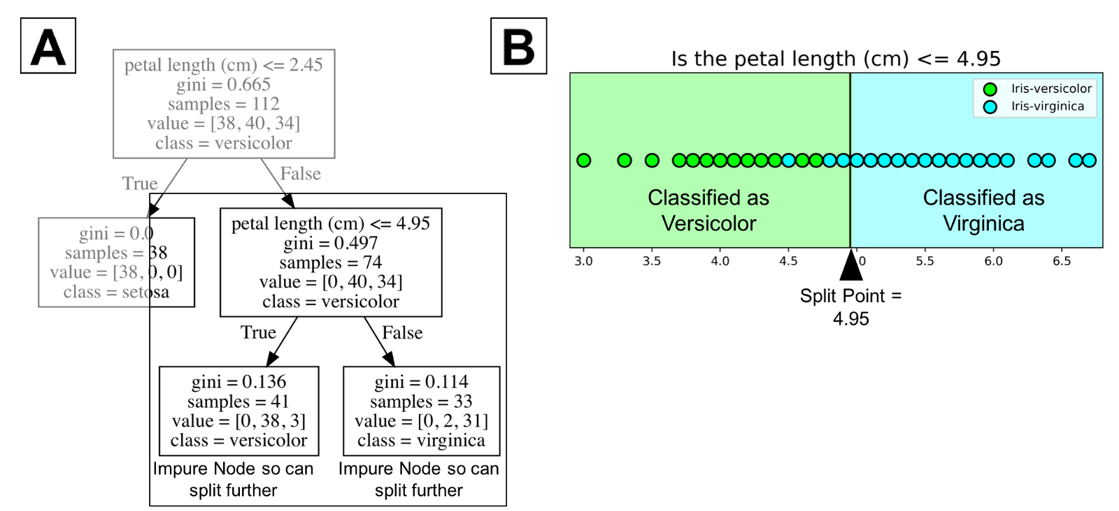
How to use a classification tree
The tree has a depth of 2. The splitting process could be continued further with more splitting until the tree is as pure as possible.
Tree depth is a measure of how many splits it makes before coming to a prediction.
The problem with many splits is that it can lead to a very deep classification tree with many nodes. This often leads to overfitting on the training dataset.
Notes:
Common practice is to assign the negative class as the absence of something (ie absence of a tumor), but it doesn’t really matter what you assign what.
positive class typically is the presence of something we are looking for.
This example is just with two classes. Later on, with our digits example, we will talk about multiclass classification problems as well. in that case our variable y can take on multiple values {0, 1, 2, 3, 4, 5, 6, 7, 8, 9}

Slide 12
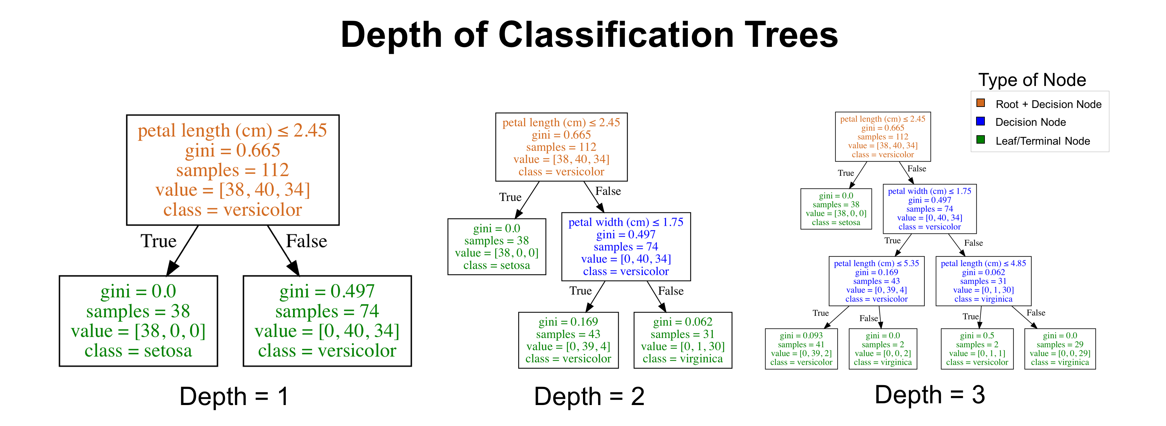
Depth of Classification Tree
Most classification tree implementations allow you to control for the maximum depth of a tree.
Notes:
Common practice is to assign the negative class as the absence of something (ie absence of a tumor), but it doesn’t really matter what you assign what.
positive class typically is the presence of something we are looking for.
This example is just with two classes. Later on, with our digits example, we will talk about multiclass classification problems as well. in that case our variable y can take on multiple values {0, 1, 2, 3, 4, 5, 6, 7, 8, 9}

Slide 13
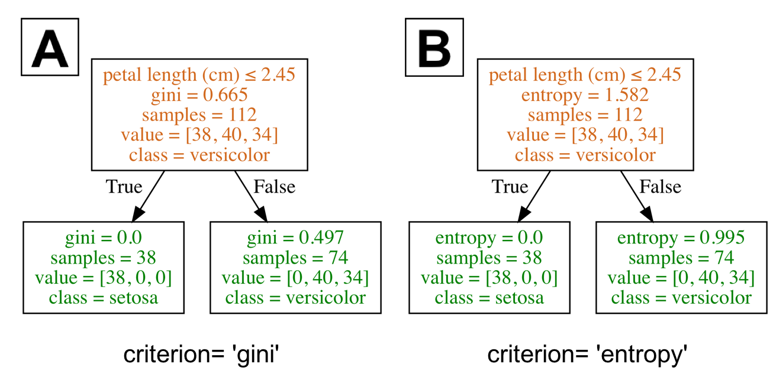
The Selection Criterion
Decision trees split on the feature and corresponding split point that results in the largest information gain (IG).
There are two criterion that we will examine: gini and entropy
We can loosely define information gain for a given criterion as:
IG = information before splitting (parent) – information after (children)
Notes:
Common practice is to assign the negative class as the absence of something (ie absence of a tumor), but it doesn’t really matter what you assign what.
positive class typically is the presence of something we are looking for.
This example is just with two classes. Later on, with our digits example, we will talk about multiclass classification problems as well. in that case our variable y can take on multiple values {0, 1, 2, 3, 4, 5, 6, 7, 8, 9}

Slide 14
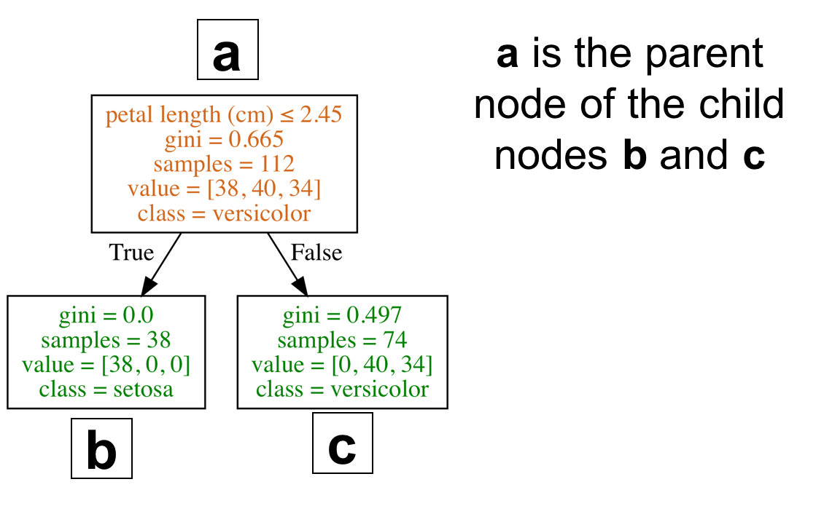
The Selection Criterion
Decision trees split on the feature and corresponding split point that results in the largest information gain (IG).
There are two criterion that we will examine: gini and entropy
We can loosely define information gain for a given criterion as:
IG = information before splitting (parent) – information after (children)
Notes:
Common practice is to assign the negative class as the absence of something (ie absence of a tumor), but it doesn’t really matter what you assign what.
positive class typically is the presence of something we are looking for.
This example is just with two classes. Later on, with our digits example, we will talk about multiclass classification problems as well. in that case our variable y can take on multiple values {0, 1, 2, 3, 4, 5, 6, 7, 8, 9}

Slide 15
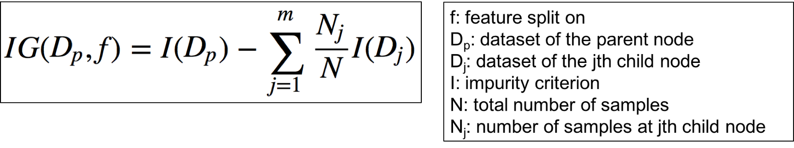
The Selection Criterion
A more proper formula is defined on the right .
Notes:
Common practice is to assign the negative class as the absence of something (ie absence of a tumor), but it doesn’t really matter what you assign what.
positive class typically is the presence of something we are looking for.
This example is just with two classes. Later on, with our digits example, we will talk about multiclass classification problems as well. in that case our variable y can take on multiple values {0, 1, 2, 3, 4, 5, 6, 7, 8, 9}

Slide 16
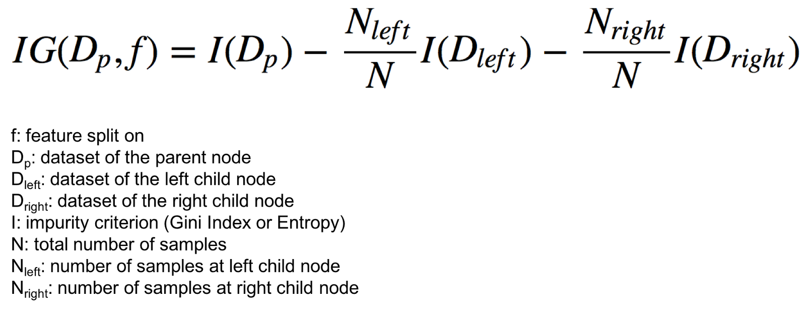
The Selection Criterion
Since classification trees have binary splits, the formula can be simplified (no summation symbol anymore)
Notes:
Common practice is to assign the negative class as the absence of something (ie absence of a tumor), but it doesn’t really matter what you assign what.
positive class typically is the presence of something we are looking for.
This example is just with two classes. Later on, with our digits example, we will talk about multiclass classification problems as well. in that case our variable y can take on multiple values {0, 1, 2, 3, 4, 5, 6, 7, 8, 9}

Slide 17
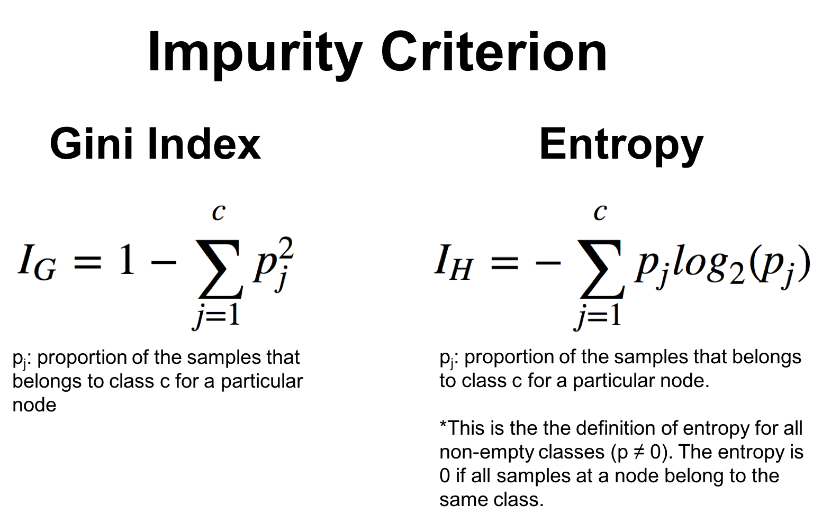
The Selection Criterion
Since classification trees have binary splits, the formula can be simplified (no summation symbol anymore)
Notes:
Common practice is to assign the negative class as the absence of something (ie absence of a tumor), but it doesn’t really matter what you assign what.
positive class typically is the presence of something we are looking for.
This example is just with two classes. Later on, with our digits example, we will talk about multiclass classification problems as well. in that case our variable y can take on multiple values {0, 1, 2, 3, 4, 5, 6, 7, 8, 9}

Slide 18
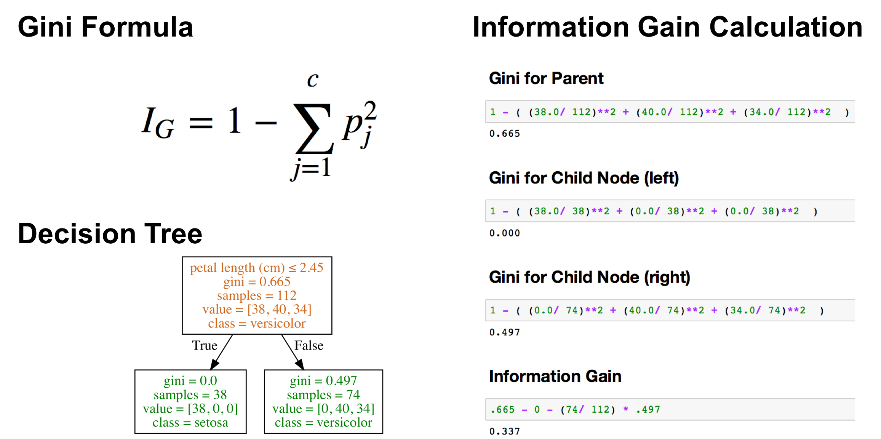
Understanding the Formula (Gini)
Notes:
For the sake of understanding these formulas a bit better, the image below shows how information gain was calculated for a decision tree with Gini criterion.
Common practice is to assign the negative class as the absence of something (ie absence of a tumor), but it doesn’t really matter what you assign what.
positive class typically is the presence of something we are looking for.
This example is just with two classes. Later on, with our digits example, we will talk about multiclass classification problems as well. in that case our variable y can take on multiple values {0, 1, 2, 3, 4, 5, 6, 7, 8, 9}

Slide 19
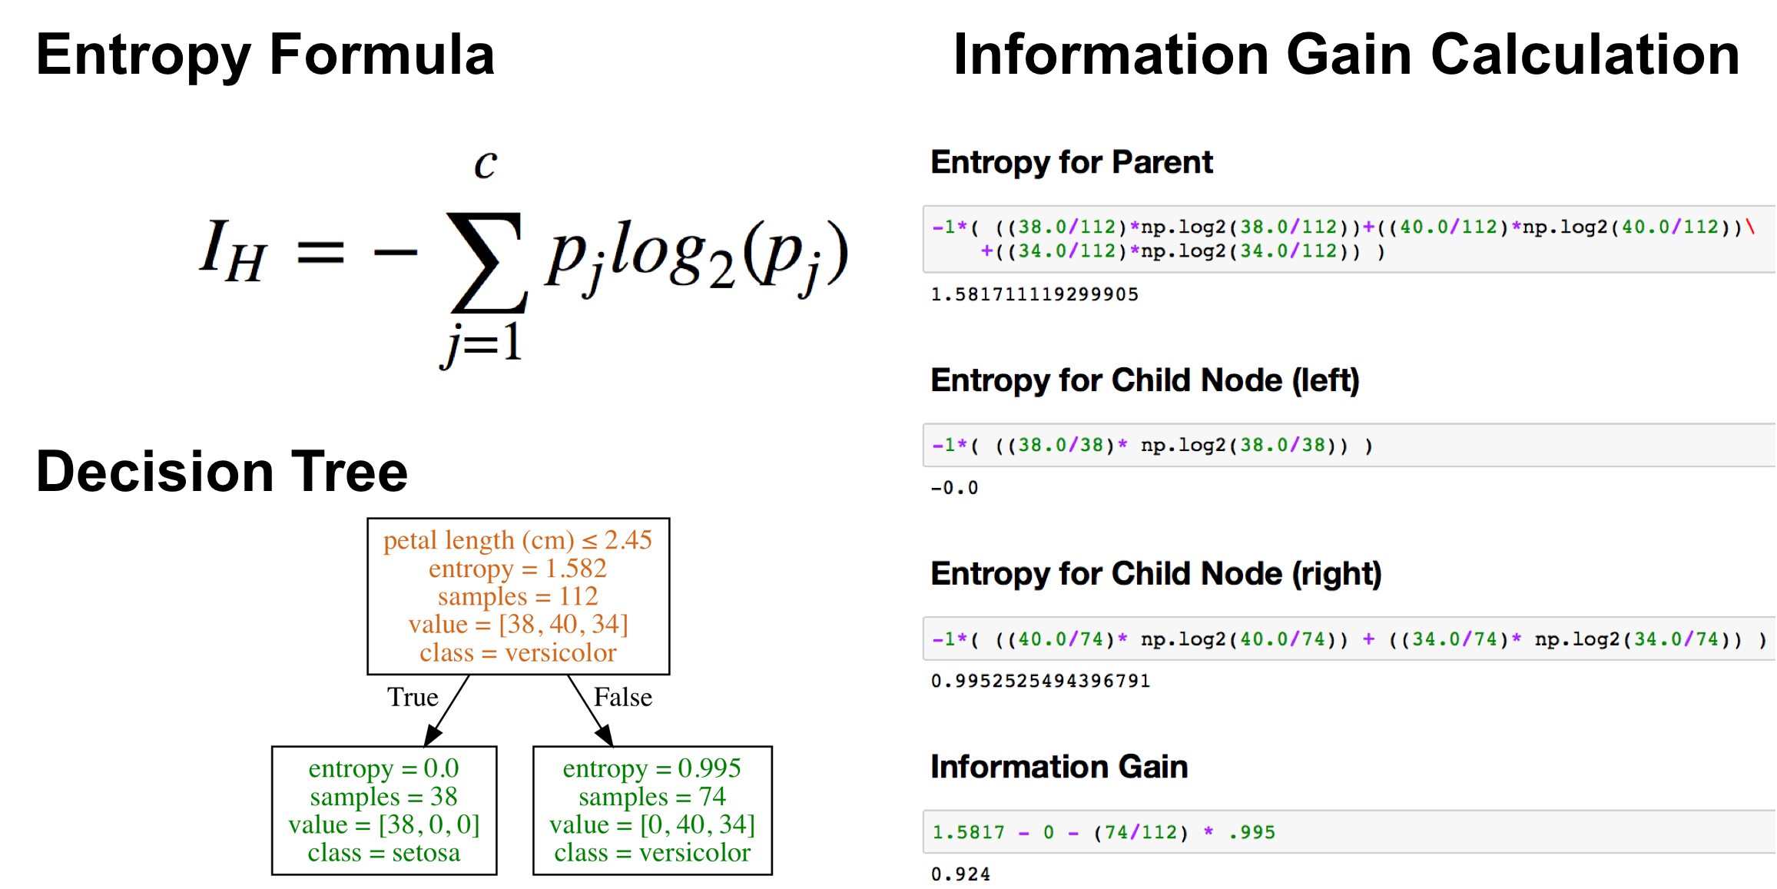
Understanding the Formula (Entropy)
Notes:
For the sake of understanding these formulas a bit better, the image below shows how information gain was calculated for a decision tree with Entropy.
Common practice is to assign the negative class as the absence of something (ie absence of a tumor), but it doesn’t really matter what you assign what.
positive class typically is the presence of something we are looking for.
This example is just with two classes. Later on, with our digits example, we will talk about multiclass classification problems as well. in that case our variable y can take on multiple values {0, 1, 2, 3, 4, 5, 6, 7, 8, 9}

Slide 20
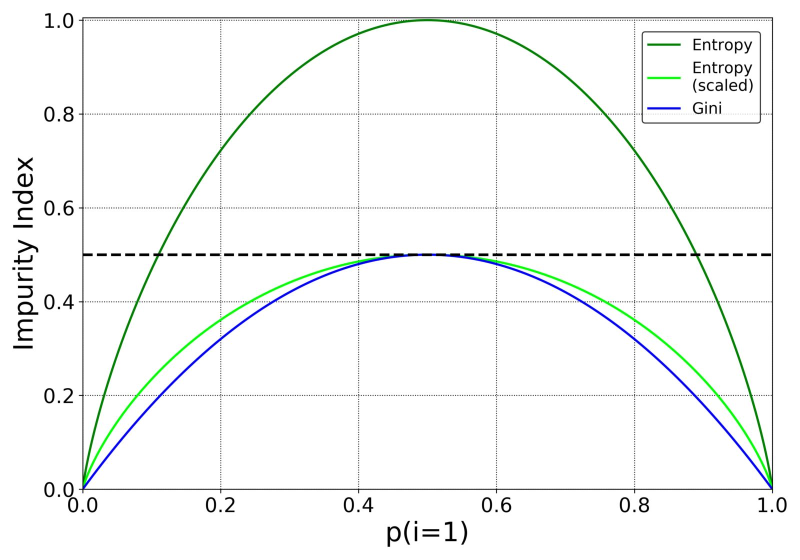
Does the Selection Criterion even Matter?
I should note that a particular selection criterion doesn’t usually matter as they are quite consistent with each other.
The strategy used to prune the tree usually has a greater impact on the final tree than the choice of impurity measures. We will see more of this.
Different impurity measures (Gini index and entropy) usually yield similar results.
Notes:
https://datascience.stackexchange.com/questions/10228/gini-impurity-vs-entropy
Common practice is to assign the negative class as the absence of something (ie absence of a tumor), but it doesn’t really matter what you assign what.
positive class typically is the presence of something we are looking for.
This example is just with two classes. Later on, with our digits example, we will talk about multiclass classification problems as well. in that case our variable y can take on multiple values {0, 1, 2, 3, 4, 5, 6, 7, 8, 9}

Slide 21
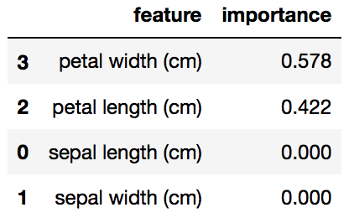
Feature Importance
Gini importance of each feature: the (normalized) total reduction of error brought by that feature
Notes:
Common practice is to assign the negative class as the absence of something (ie absence of a tumor), but it doesn’t really matter what you assign what.
positive class typically is the presence of something we are looking for.
This example is just with two classes. Later on, with our digits example, we will talk about multiclass classification problems as well. in that case our variable y can take on multiple values {0, 1, 2, 3, 4, 5, 6, 7, 8, 9}

Slide 22
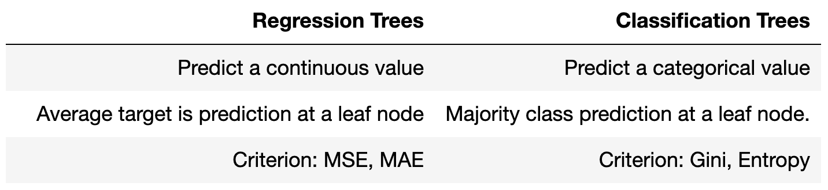
Decision trees for regression versus classification
Decision trees used for regression are called regression trees.
Instead of returning a class, its leaf returns a single numeric value for each set of conditions.
Some differences between regression and classification trees
Notes:
Common practice is to assign the negative class as the absence of something (ie absence of a tumor), but it doesn’t really matter what you assign what.
positive class typically is the presence of something we are looking for.
This example is just with two classes. Later on, with our digits example, we will talk about multiclass classification problems as well. in that case our variable y can take on multiple values {0, 1, 2, 3, 4, 5, 6, 7, 8, 9}

Slide 23
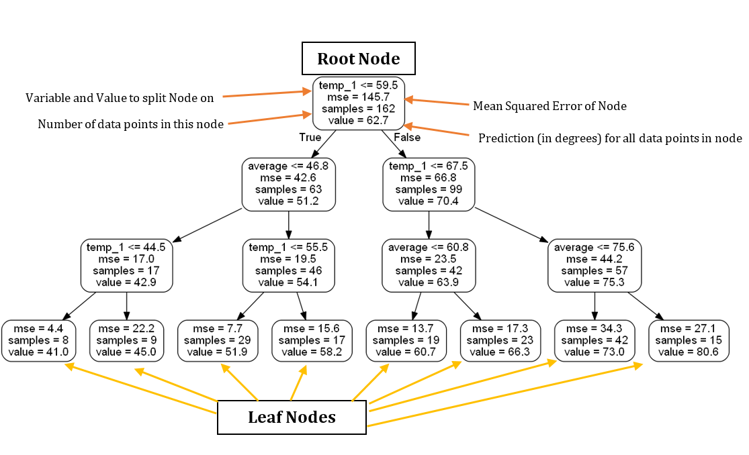
What are Regression Trees?
Decision trees used for regression are called regression trees.
Instead of returning a class, its leaf returns a single numeric value for each set of conditions.
Regression tree
Notes:
Common practice is to assign the negative class as the absence of something (ie absence of a tumor), but it doesn’t really matter what you assign what.
positive class typically is the presence of something we are looking for.
This example is just with two classes. Later on, with our digits example, we will talk about multiclass classification problems as well. in that case our variable y can take on multiple values {0, 1, 2, 3, 4, 5, 6, 7, 8, 9}

Slide 24
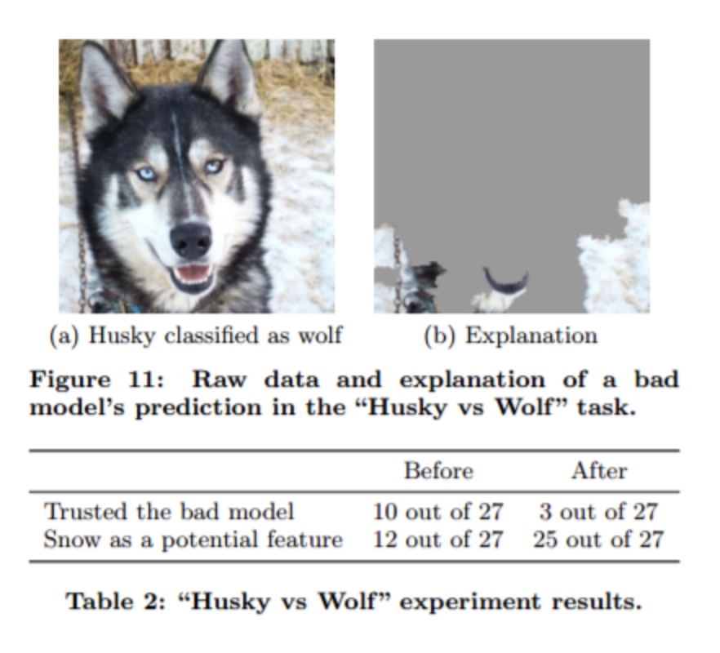
Importance of trying to visualize your Model
Often artifacts of data collection can induce undesirable correlations that the classifiers can pick up during training.
These issues can be very difficult to identify just by looking at the raw data and predictions.
https://arxiv.org/pdf/1602.04938.pdf
Notes:
https://arxiv.org/abs/1602.04938
https://hackernoon.com/dogs-wolves-data-science-and-why-machines-must-learn-like-humans-do-41c43bc7f982
Understanding the reasons behind predictions is important in assessing trust, which is fundamental if one plans to take action based on a prediction, or when choosing to whether to deploy a new model.
Despite widespread adoption, machine learning models remain mostly black boxes. Understanding the reasons behind predictions is, however, quite important in assessing trust, which is fundamental if one plans to take action based on a prediction, or when choosing whether to deploy a new model.
Despite widespread adoption, machine learning models remain mostly black boxes. Understanding the reasons behind predictions is, however, quite important in assessing trust, which is fundamental if one plans to take action based on a prediction, or when choosing whether to deploy a new model.

Slide 25
Importance of trying to visualize your Model
This task was to distinguish between photos of Wolves and Eskimo Dogs (huskies)
“We train a logistic regression classifier on a training set of 20 images, hand selected such that all pictures of wolves had snow in the background, while pictures of huskies did not. As the features for the images, we use the first max-pooling layer of Google’s pre-trained Inception neural network. On a collection of additional 60 images, the classifier predicts Wolf if there is snow (or light background at the bottom), and Husky otherwise, regardless of animal color, position, pose, etc. We trained this bad classifier intentionally, to evaluate whether subjects are able to detect it.”
https://arxiv.org/pdf/1602.04938.pdf
Notes:
https://arxiv.org/abs/1602.04938
https://hackernoon.com/dogs-wolves-data-science-and-why-machines-must-learn-like-humans-do-41c43bc7f982
Understanding the reasons behind predictions is important in assessing trust, which is fundamental if one plans to take action based on a prediction, or when choosing to whether to deploy a new model.
Despite widespread adoption, machine learning models remain mostly black boxes. Understanding the reasons behind predictions is, however, quite important in assessing trust, which is fundamental if one plans to take action based on a prediction, or when choosing whether to deploy a new model.

Slide 26
Importance of trying to visualize your Model
It didn’t learn the differences between dogs and wolves, but instead learned that wolves were on snow in their pictures and dogs were on grass (in most cases).
Models erroneously tuned to implicit bias in samples actually happens quite often. While this not something we can solve in a course like this, it is something to mention.
https://arxiv.org/pdf/1602.04938.pdf
Notes:
https://arxiv.org/abs/1602.04938
https://hackernoon.com/dogs-wolves-data-science-and-why-machines-must-learn-like-humans-do-41c43bc7f982
Understanding the reasons behind predictions is important in assessing trust, which is fundamental if one plans to take action based on a prediction, or when choosing to whether to deploy a new model.
Despite widespread adoption, machine learning models remain mostly black boxes. Understanding the reasons behind predictions is, however, quite important in assessing trust, which is fundamental if one plans to take action based on a prediction, or when choosing whether to deploy a new model.

Slide 27
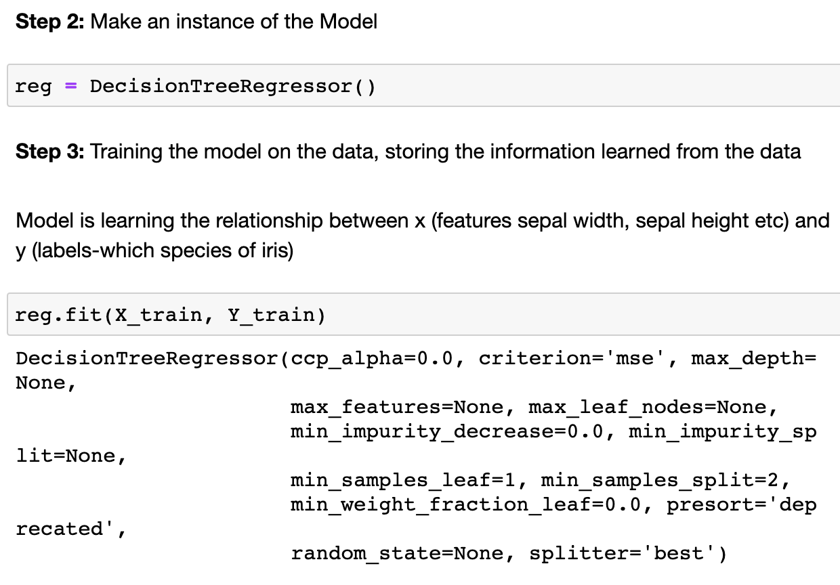
Visualize Decision Trees Process
Fit a Decision Tree Model using Scikit-Learn
Convert your model to an image
Option 1: Graphviz
Option 2: Online Converter
Option 3: Matplotlib
Fit the decision tree model
Notes:
Common practice is to assign the negative class as the absence of something (ie absence of a tumor), but it doesn’t really matter what you assign what.
positive class typically is the presence of something we are looking for.
This example is just with two classes. Later on, with our digits example, we will talk about multiclass classification problems as well. in that case our variable y can take on multiple values {0, 1, 2, 3, 4, 5, 6, 7, 8, 9}

Slide 28
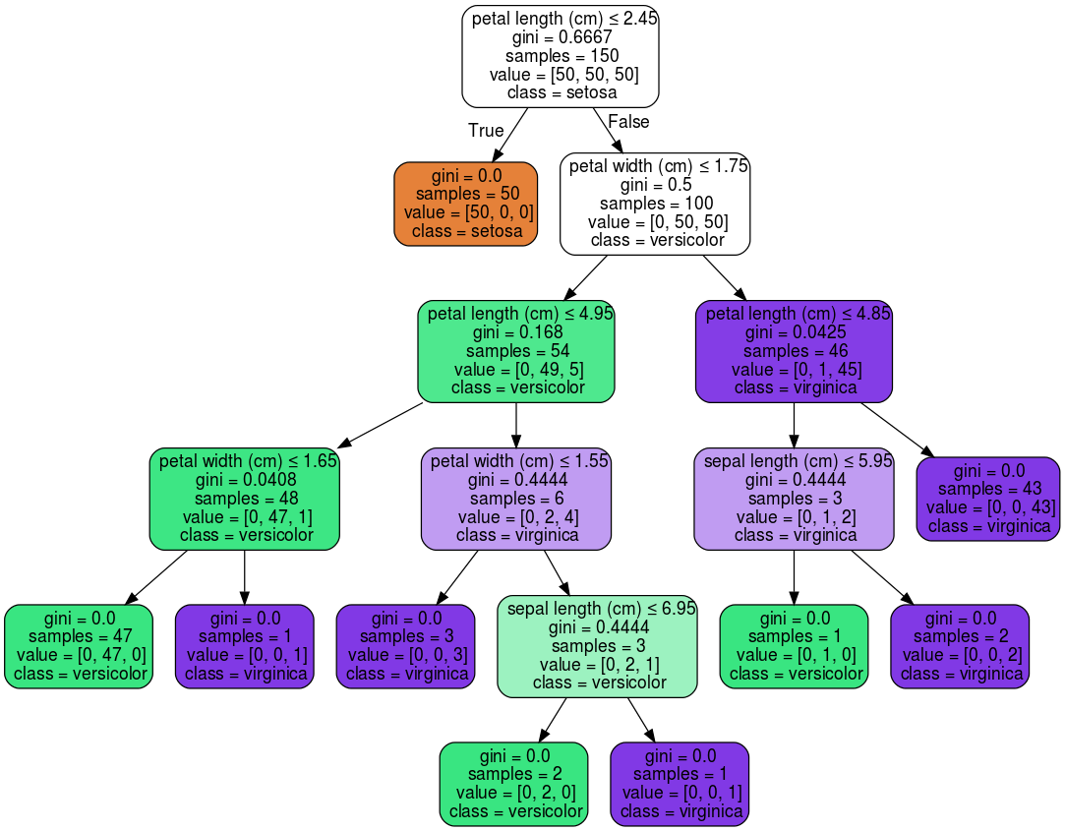
Visualize Decision Trees Process
Fit a Decision Tree Model using Scikit-Learn
Convert your model to an image
Option 1: Graphviz
Option 2: Online Converter
Option 3: Matplotlib
Notes:
Common practice is to assign the negative class as the absence of something (ie absence of a tumor), but it doesn’t really matter what you assign what.
positive class typically is the presence of something we are looking for.
This example is just with two classes. Later on, with our digits example, we will talk about multiclass classification problems as well. in that case our variable y can take on multiple values {0, 1, 2, 3, 4, 5, 6, 7, 8, 9}

Slide 29
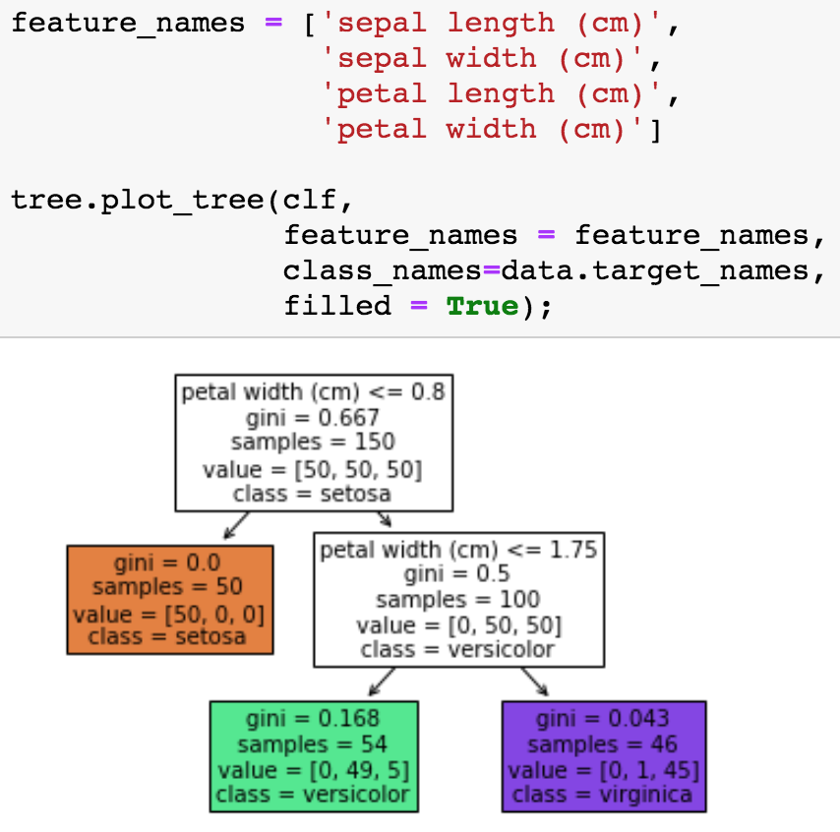
Graphviz
Graphviz is open source graph visualization software. Graph visualization is a way of representing structural information as diagrams of abstract graphs and networks. In data science, one use of Graphviz is to visualize decision trees.
Fit the decision tree model
Notes:
Common practice is to assign the negative class as the absence of something (ie absence of a tumor), but it doesn’t really matter what you assign what.
positive class typically is the presence of something we are looking for.
This example is just with two classes. Later on, with our digits example, we will talk about multiclass classification problems as well. in that case our variable y can take on multiple values {0, 1, 2, 3, 4, 5, 6, 7, 8, 9}

Slide 30
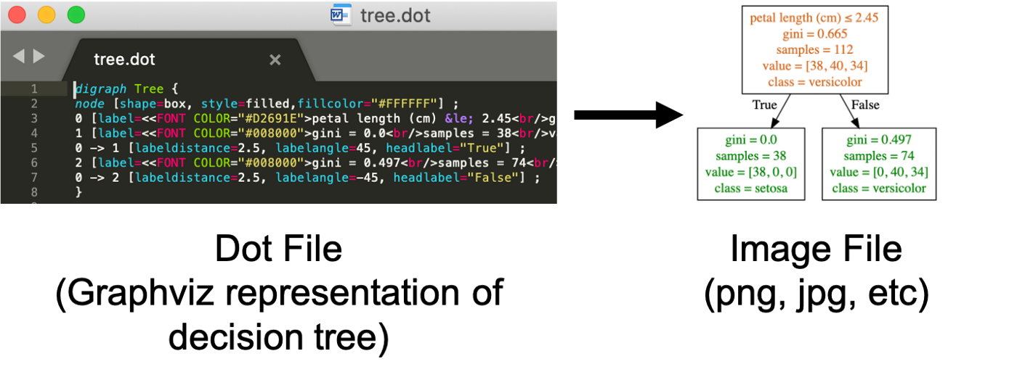
Graphviz
Create a dot file (easy)
Convert dot file to image
Creating the dot file is usually not a problem. Converting the dot file to a png file can be difficult.
Notes:
Common practice is to assign the negative class as the absence of something (ie absence of a tumor), but it doesn’t really matter what you assign what.
positive class typically is the presence of something we are looking for.
This example is just with two classes. Later on, with our digits example, we will talk about multiclass classification problems as well. in that case our variable y can take on multiple values {0, 1, 2, 3, 4, 5, 6, 7, 8, 9}

Slide 31
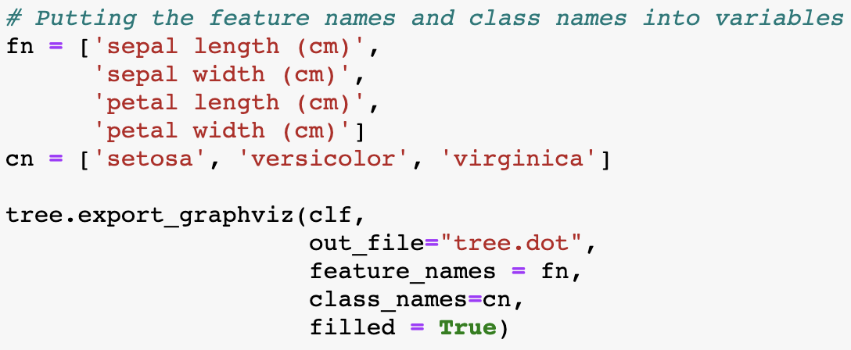
Graphviz
Create a dot file (easy)
Convert dot file to image
Creating the dot file is usually not a problem. Converting the dot file to a png file can be difficult.
Notes:
Common practice is to assign the negative class as the absence of something (ie absence of a tumor), but it doesn’t really matter what you assign what.
positive class typically is the presence of something we are looking for.
This example is just with two classes. Later on, with our digits example, we will talk about multiclass classification problems as well. in that case our variable y can take on multiple values {0, 1, 2, 3, 4, 5, 6, 7, 8, 9}

Slide 32
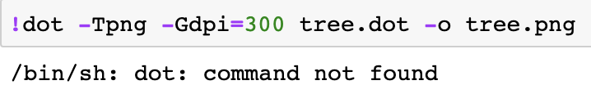
Installing Graphviz
There are a couple ways to do this including: installing python-graphviz though Anaconda, installing Graphviz through Homebrew (Mac), and installing Graphviz executables from the official site (Windows).
Sometimes errors can happen if you try and convert the dot file to png. Just keep in mind that installations can be difficult, but they are a part of machine learning
Notes:
https://stackoverflow.com/questions/49853303/how-to-install-pydot-graphviz-on-google-colab

Slide 33
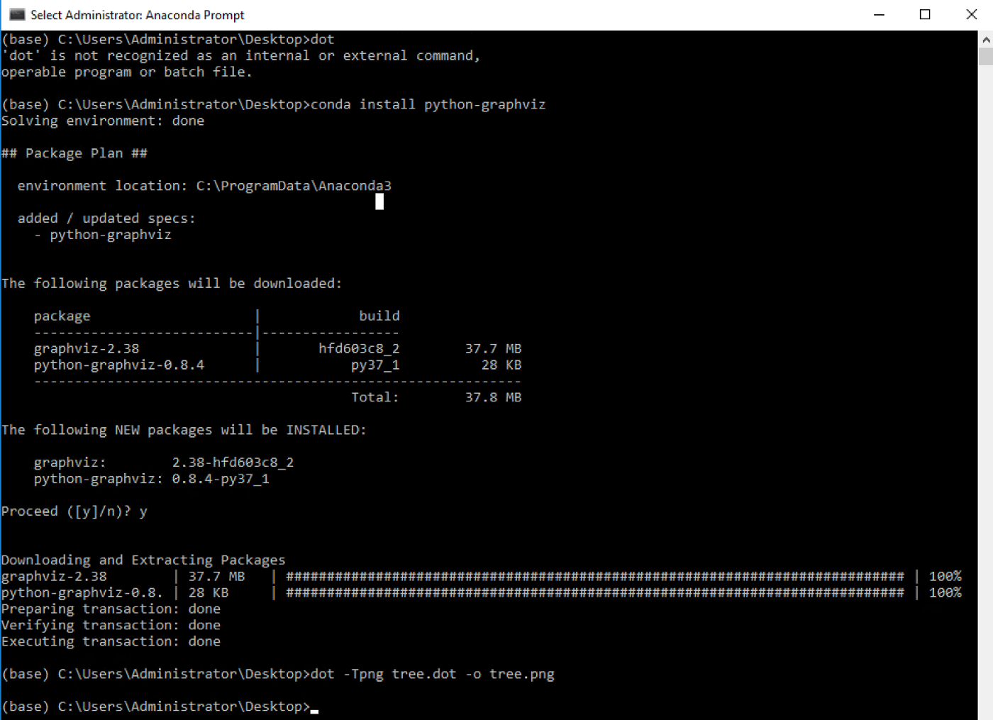
Installing Graphviz
There are a couple ways to do this including: installing python-graphviz though Anaconda, installing Graphviz through Homebrew (Mac), and installing Graphviz executables from the official site (Windows).
Installations can be difficult, but they are a part of machine learning
Notes:
https://stackoverflow.com/questions/49853303/how-to-install-pydot-graphviz-on-google-colab

Slide 34
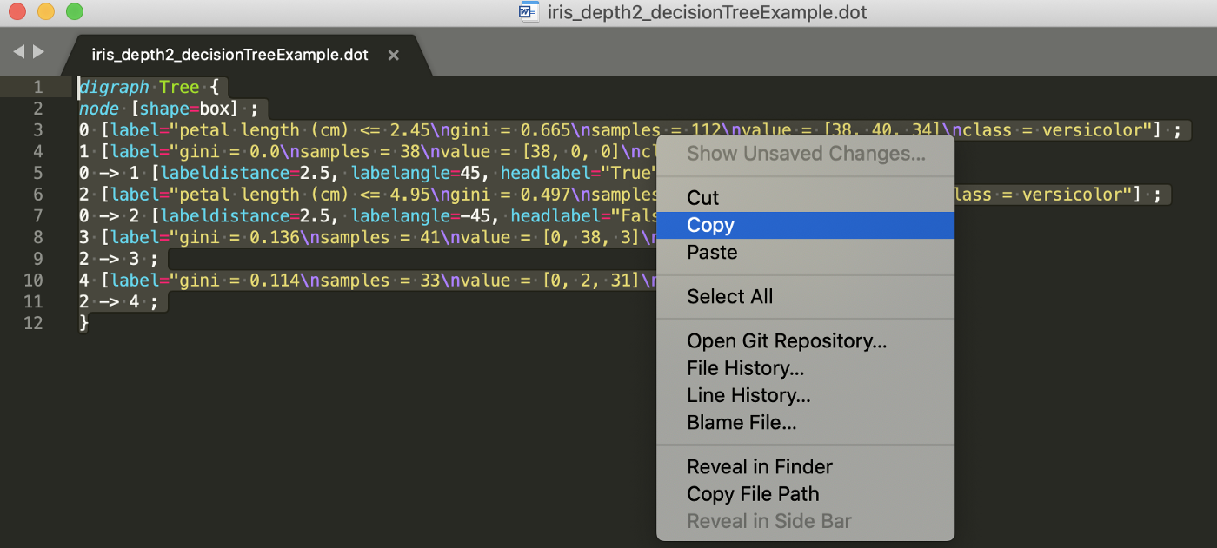
Don’t like Installing Graphviz?
You can use an online converter.
Installations can be difficult, but they are a part of machine learning
Copy the contents of the dot file
Notes:
https://stackoverflow.com/questions/49853303/how-to-install-pydot-graphviz-on-google-colab

Slide 35
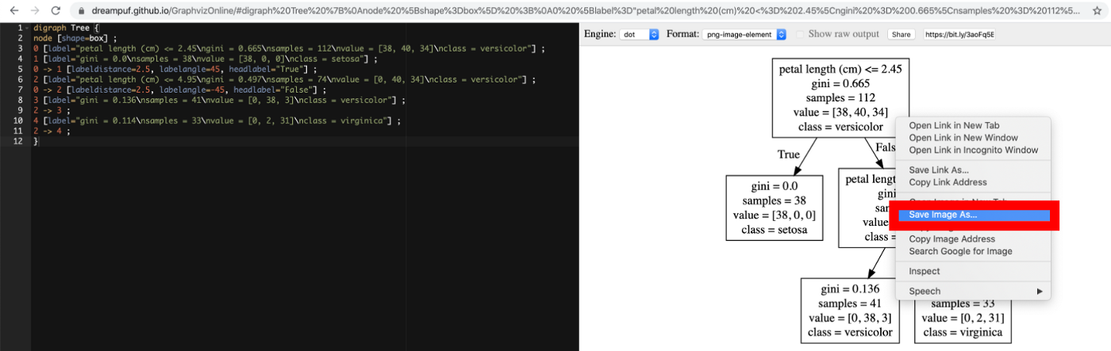
Don’t like Installing Graphviz?
You can use an online converter.
Installations can be difficult, but they are a part of machine learning
Save visualization to computer
Notes:
https://stackoverflow.com/questions/49853303/how-to-install-pydot-graphviz-on-google-colab

Slide 36
Creating a Tree Diagram with Matplotlib (Wrapper)
You can also create decision trees using Matplotlib (relatively new feature)
This avoids using Graphviz (hard to install)
Notes:
https://github.com/parrt/dtreeviz
https://explained.ai/decision-tree-viz/
Common practice is to assign the negative class as the absence of something (ie absence of a tumor), but it doesn’t really matter what you assign what.
positive class typically is the presence of something we are looking for.
This example is just with two classes. Later on, with our digits example, we will talk about multiclass classification problems as well. in that case our variable y can take on multiple values {0, 1, 2, 3, 4, 5, 6, 7, 8, 9}

Slide 37
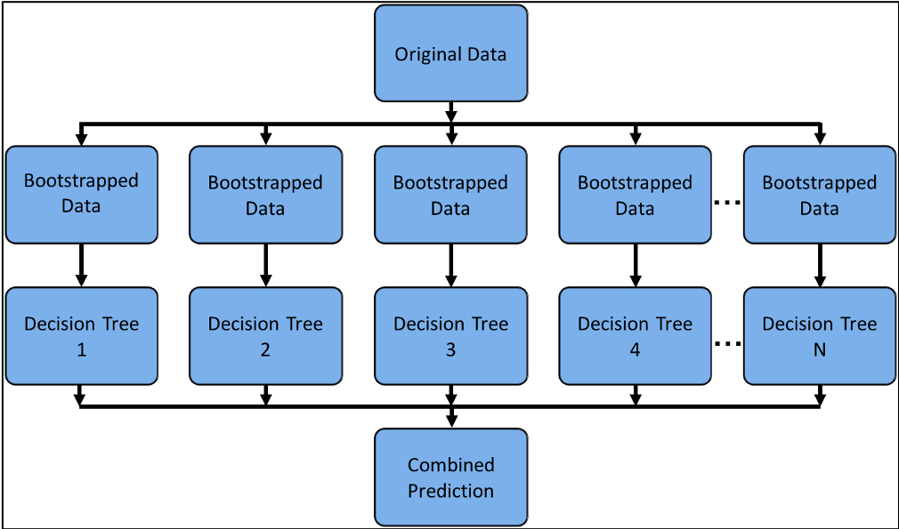
How to Visualize Individual Decision Trees from Bagged Trees or Random Forests
While random forests are a subject for a later lecture, I want to let you know that what we learn is building toward other topics.
The image above could be a diagram for Bagged Trees or Random Forests models which are ensemble methods. This means using multiple learning algorithms to obtain a better predictive performance than could be obtained from any of the constituent learning algorithms alone.
Notes:
https://github.com/parrt/dtreeviz
https://explained.ai/decision-tree-viz/
Common practice is to assign the negative class as the absence of something (ie absence of a tumor), but it doesn’t really matter what you assign what.
positive class typically is the presence of something we are looking for.
This example is just with two classes. Later on, with our digits example, we will talk about multiclass classification problems as well. in that case our variable y can take on multiple values {0, 1, 2, 3, 4, 5, 6, 7, 8, 9}

Slide 38
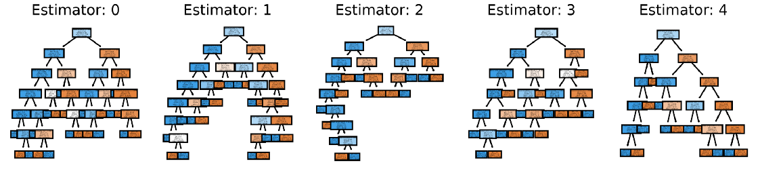
How to Visualize Individual Decision Trees from Bagged Trees or Random Forests
Notes:
https://github.com/parrt/dtreeviz
https://explained.ai/decision-tree-viz/
Common practice is to assign the negative class as the absence of something (ie absence of a tumor), but it doesn’t really matter what you assign what.
positive class typically is the presence of something we are looking for.
This example is just with two classes. Later on, with our digits example, we will talk about multiclass classification problems as well. in that case our variable y can take on multiple values {0, 1, 2, 3, 4, 5, 6, 7, 8, 9}

Slide 39
Creating a Tree Diagram
To create a tree diagram, you can use the Graphviz library for displaying graph data structures.
Notes:
Common practice is to assign the negative class as the absence of something (ie absence of a tumor), but it doesn’t really matter what you assign what.
positive class typically is the presence of something we are looking for.
This example is just with two classes. Later on, with our digits example, we will talk about multiclass classification problems as well. in that case our variable y can take on multiple values {0, 1, 2, 3, 4, 5, 6, 7, 8, 9}

Slide 40
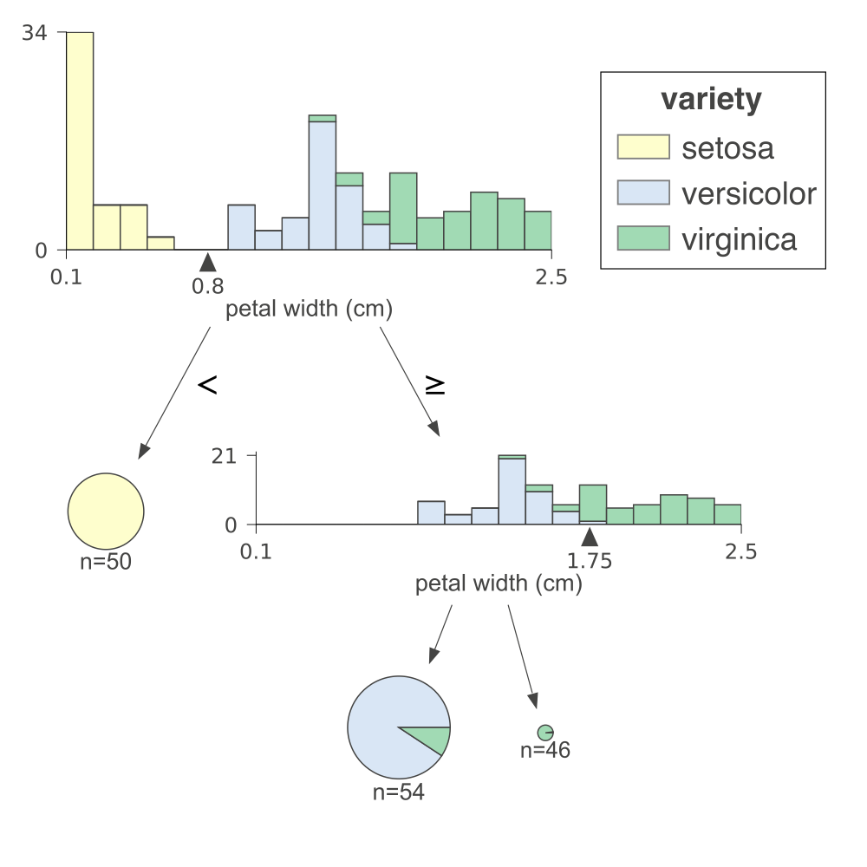
Creating a Tree Diagram
You can also use the dtreeviz library which again requires graphviz.
dtreeviz is a new library so I imagine it will have further improvements.
Keep in mind, there isn’t a widely known matplotlib way to make this sort of graphs automatically.
Notes:
https://github.com/parrt/dtreeviz
https://explained.ai/decision-tree-viz/
Common practice is to assign the negative class as the absence of something (ie absence of a tumor), but it doesn’t really matter what you assign what.
positive class typically is the presence of something we are looking for.
This example is just with two classes. Later on, with our digits example, we will talk about multiclass classification problems as well. in that case our variable y can take on multiple values {0, 1, 2, 3, 4, 5, 6, 7, 8, 9}

Slide 41
Creating a Tree Diagram with Matplotlib (Wrapper)
You can also create a decision trees using Matplotlib (relatively new feature)
Notes:
https://github.com/parrt/dtreeviz
https://explained.ai/decision-tree-viz/
Common practice is to assign the negative class as the absence of something (ie absence of a tumor), but it doesn’t really matter what you assign what.
positive class typically is the presence of something we are looking for.
This example is just with two classes. Later on, with our digits example, we will talk about multiclass classification problems as well. in that case our variable y can take on multiple values {0, 1, 2, 3, 4, 5, 6, 7, 8, 9}

Slide 42
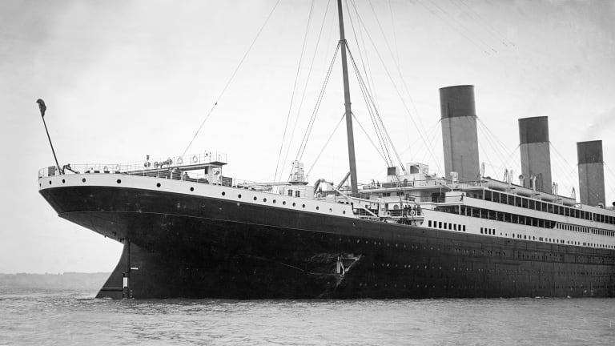
Titanic Exercise
Dataset is characteristics of passengers on Titanic
The challenge is about predicting who survived from characteristics (age, gender, ticket information…)

Slide 43

House Sales in King County Exercise
Dataset contains house sales prices for King County, which includes Seattle (homes sold between May 2014 and May 2015)
The challenge is about predicting house prices based on bedrooms, floors, zipcode etc.

